Slide 1
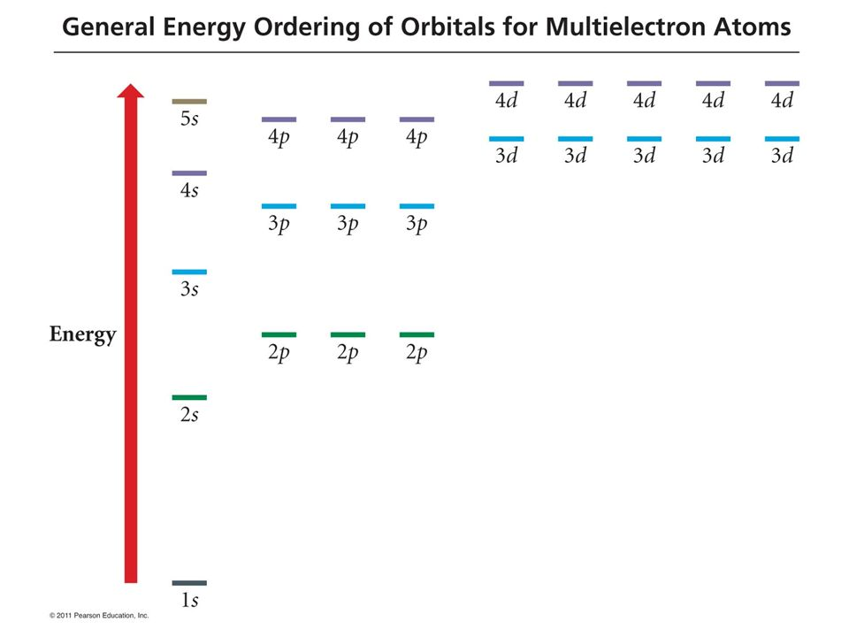
Neon: $\left[He\right]$2s²2p⁶ (same as $1s^{2}$2s²2p⁶)
HOMO
Spartan doesn’t even display this (core) orbital

Slide 2
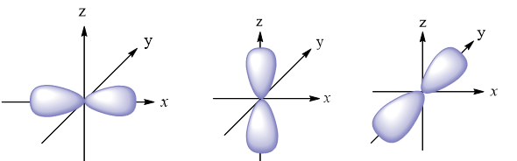
Neon: $\left[He\right]$2s²2p⁶ (same as $1s^{2}$2s²2p⁶)
HOMO
Spartan doesn’t even display this (core) orbital

Slide 3
Neon: $\left[He\right]$2s²2p⁶ (same as $1s^{2}$2s²2p⁶)
HOMO
But our GEOO diagram got the LUMO wrong … can you tell how?
Spartan doesn’t even display this (core) orbital

Slide 4
Neon: $\left[He\right]$2s²2p⁶ (same as $1s^{2}$2s²2p⁶)
GEOO says this is the LUMO
HOMO
Spartan doesn’t even display this (core) orbital

Slide 5
Neon: $\left[He\right]$2s²2p⁶ (same as $1s^{2}$2s²2p⁶)
But Spartan says this is the LUMO
HOMO
Spartan doesn’t even display this (core) orbital

Slide 6
Argon: $\left[Ne\right]$3s²3p⁶ (or 1s²2s²2p⁶ 3s²3p⁶)
Spartan labels these HOMO
Spartan doesn’t even display these (core) orbitals

Slide 7
Argon: $\left[Ne\right]$3s²3p⁶
Spartan labels these HOMO
Spartan doesn’t even display these (core) orbitals

Slide 8
Argon: $\left[Ne\right]$3s²3p⁶
Does Spartan’s LUMO agree with the GEOO?
Spartan labels these HOMO
Spartan doesn’t even display these (core) orbitals

Slide 9
Argon: $\left[Ne\right]$3s²3p⁶
Does Spartan’s LUMO agree with the GEOO? Yeah
LUMO
Spartan labels these HOMO
Spartan doesn’t even display these (core) orbitals

Slide 10
Argon: $\left[Ne\right]$3s²3p⁶
Does Spartan’s LUMO agree with the GEOO? Yeah
Spartan labels these HOMO
Argon is our first encounter with an unfilled shell. However, it is filled through the p-subshell, and it behaves chemically a lot like Helium and Neon (gas, doesn’t like to make bonds with other atoms) so we put it in the Noble Gas column of the period table.

Slide 11
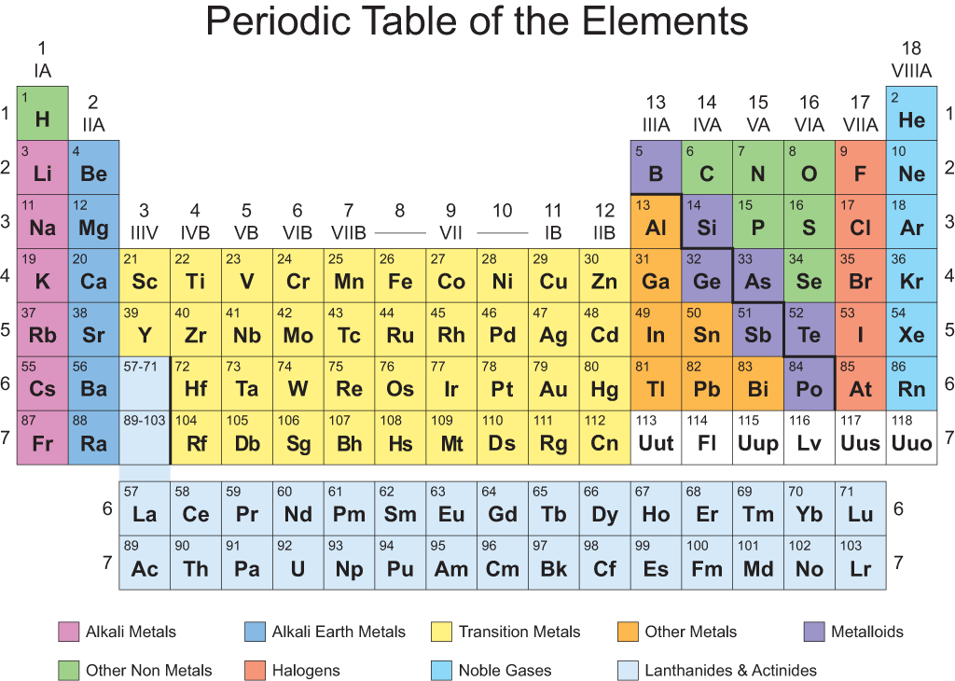
The Noble Gases

Slide 12
The Noble Gases
What about the rest of the elements?
All of them have only partially-filled shells.
To show these in Spartan, you may have to specify an unpaired electron.

